Slide 1
Data Visualization
Big Data for Health Conference 2018
David Sasson
M.S. Candidate, Health Data Science
davidsasson.info

Slide 2
I’m from Brooklyn
“NYC is the best in city in the world” – every New Yorker
Big Data for Health Conference

Slide 3
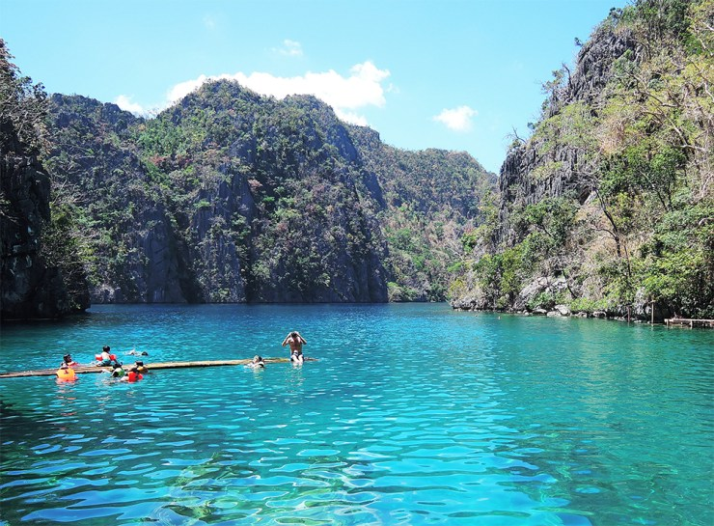
Thanks for inviting me
Pinoys know how to live!
Big Data for Health Conference

Slide 4
Introduction to ggplot2
github.com/dsasson48/dataviz
goo.gl/GXQUbz
You should have R (http://cran.r-project.org), RStudio (http://rstudio.com), and MIMIC (http://mimic.physionet.org/) installed.
THERE ARE NO DUMB QUESTIONS—PLEASE ASK TO MAKE THIS A FUN WORKSHOP ☺

Slide 5
Harvard is funding me
I need a selfie!
Big Data for Health Conference

Slide 6
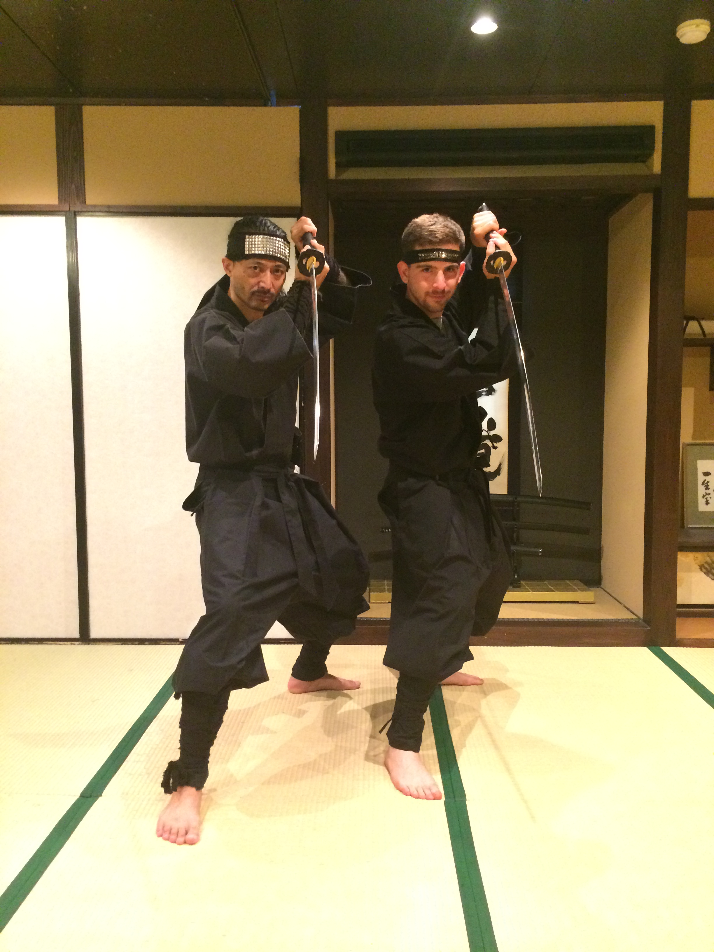
I’m building something!
I had this idea 1 week ago a Japanese ninja dojo
davidsasson.info/start
Social Infrastructure for post-Datathons
Incubator ?
Non-profit ?
No clue
If you want to get involved or have any cool ideas please get in touch
Developing idea at Harvard Innovation Labs this fall, launching Jan 2019 (fingers crossed)
Big Data for Health Conference

